Slide 1
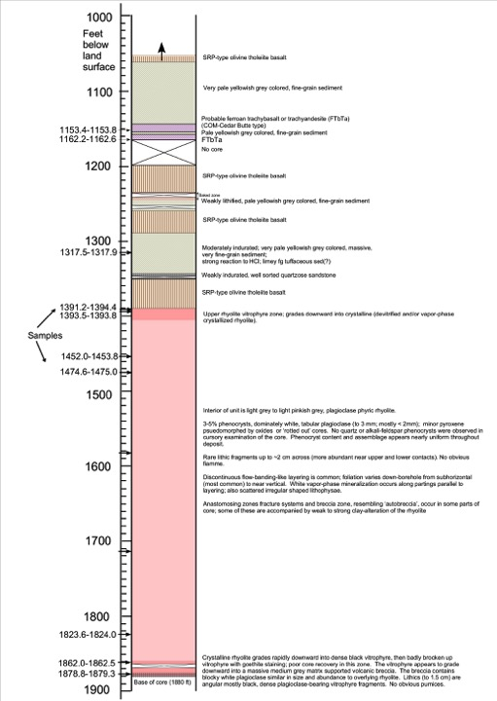
Notes:
USGS 1492_Preliminary core log

Slide 2
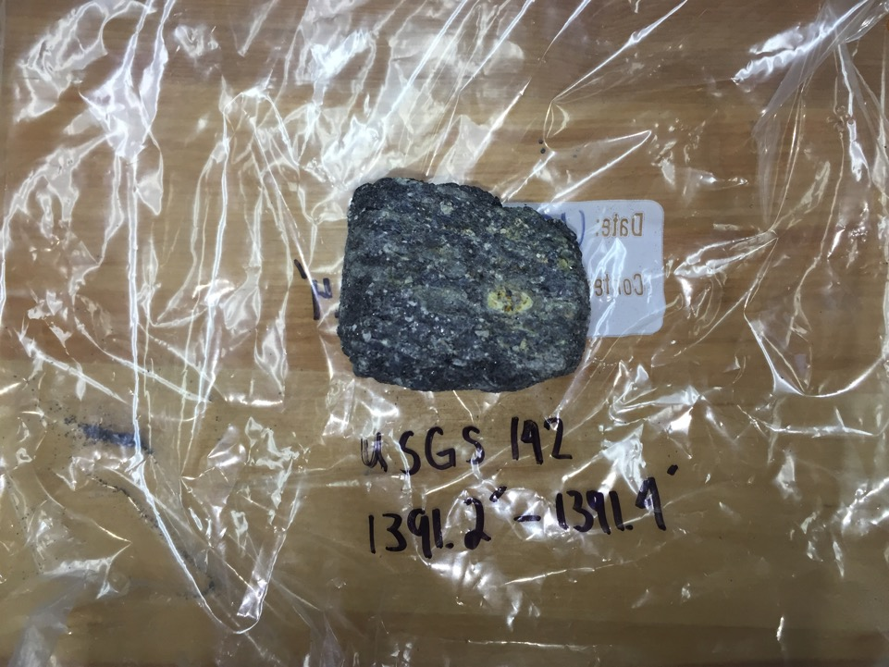
Notes:
USGS 1391_core sample.

Slide 3
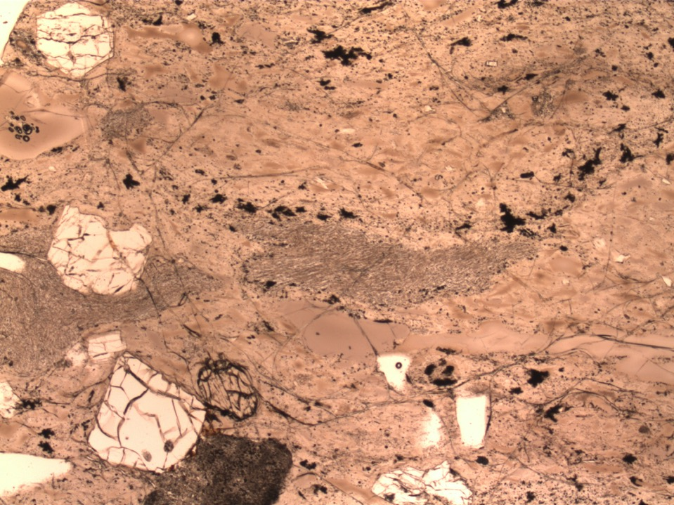
Notes:
USGS 1391_1PL_20X
Densely welded tuff vitrophyre.
7% Pl >> Qtz > Ferroaug > san (&anothoclase?), opx >> mt > ilm + accessory ap, zrn.
Significantly larger and more abundant phenocrysts in 1391 than in samples from lower (deeper) parts of ignimbrite.
At least 2 textural populations of plag: 1. large, blocky subhedral to euhedral grains with weak oscillatory to normal zoning; bands of MI’s. 2. prominent grains with anhedral, resorbed cores (antecrysts?) mantle by euhedral to subhedral rims.
Mt, ap, zrn don’t appear as abundant as in USGS 1862. Note welded pumices and vitrophyre ‘chips’.

Slide 4
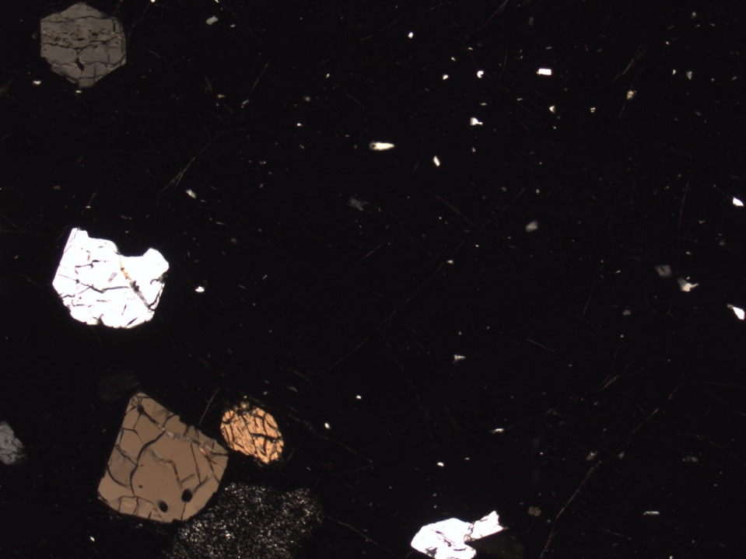
Notes:
USGS 1391_1XP_20X
Densely welded tuff vitrophyre.
7% Pl >> Qtz > Ferroaug > san (&anothoclase?), opx >> mt > ilm + accessory ap, zrn.
Significantly larger and more abundant phenocrysts in 1391 than in samples from lower (deeper) parts of ignimbrite.
At least 2 textural populations of plag: 1. large, blocky subhedral to euhedral grains with weak oscillatory to normal zoning; bands of MI’s. 2. prominent grains with anhedral, resorbed cores (antecrysts?) mantle by euhedral to subhedral rims.
Mt, ap, zrn don’t appear as abundant as in USGS 1862. Note welded pumices and vitrophyre ‘chips’.

Slide 5
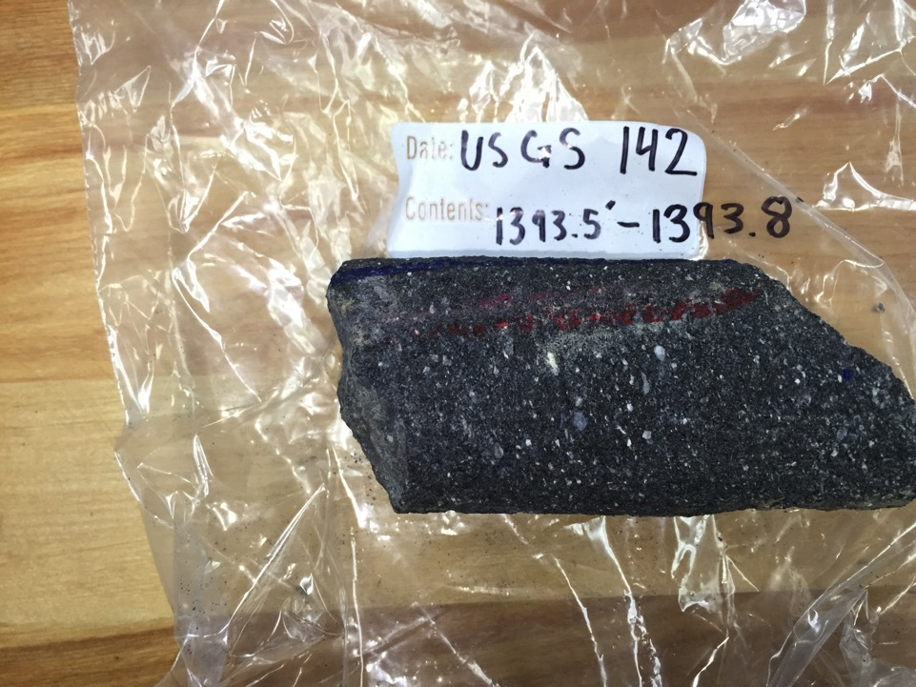
Notes:
USGS 1394 core sample
At least 2 textural populations of plag: 1. large, blocky subhedral to euhedral grains with weak oscillatory to normal zoning; bands of MI’s. 2. prominent grains with anhedral, resorbed cores (antecrysts?) mantle by euhedral to subhedral rims.
Mt, ap, zrn don’t appear as abundant as in USGS 1862. Note welded pumices and vitrophyre ‘chips’.

Slide 6
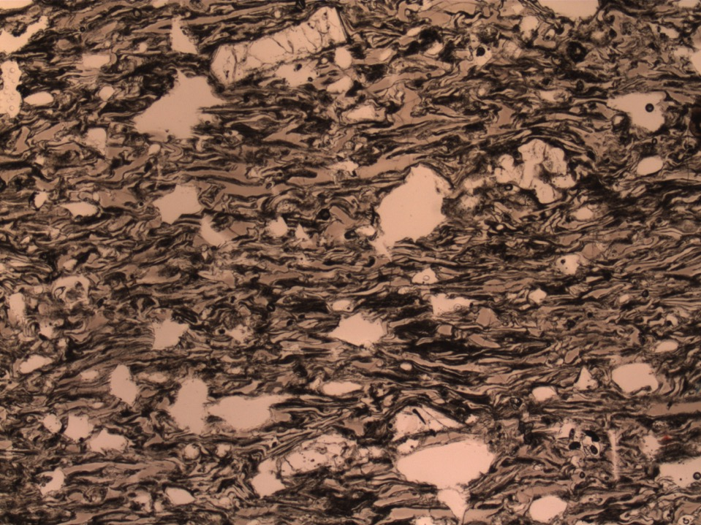
Notes:
USGS 1395_1PL_20X
Weakly welded tuff vitrophyre. Possibly rheomorphically infolded zone at tope of ignimbrite (e.g. Grey’s Landing ignimbrite)
5% Pl >> Qtz > Ferroaug (others TBD). Well defined bubble wall shards and small pumices. Some plag mantled by san.

Slide 7
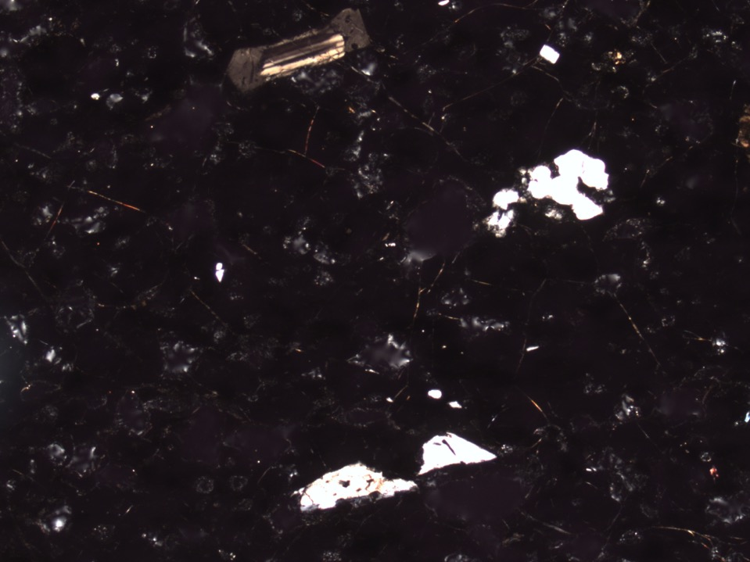
Notes:
USGS 1395_1PL_20X
Weakly welded tuff vitrophyre. Possibly rheomorphically infolded zone at tope of ignimbrite (e.g. Grey’s Landing ignimbrite)
5% Pl >> Qtz > Ferroaug (others TBD). Well defined bubble wall shards and small pumices. Some plag mantled by san.

Slide 8
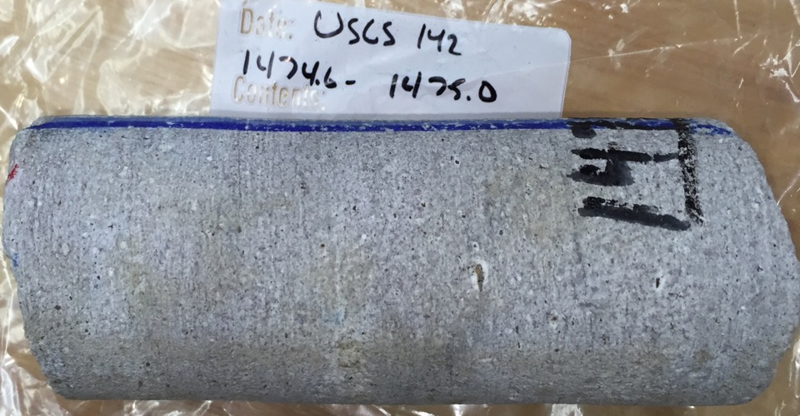
Notes:
Light grey, subhorizontally folliated plag phyric rhyolite.
(Photo: McCurry)

Slide 9
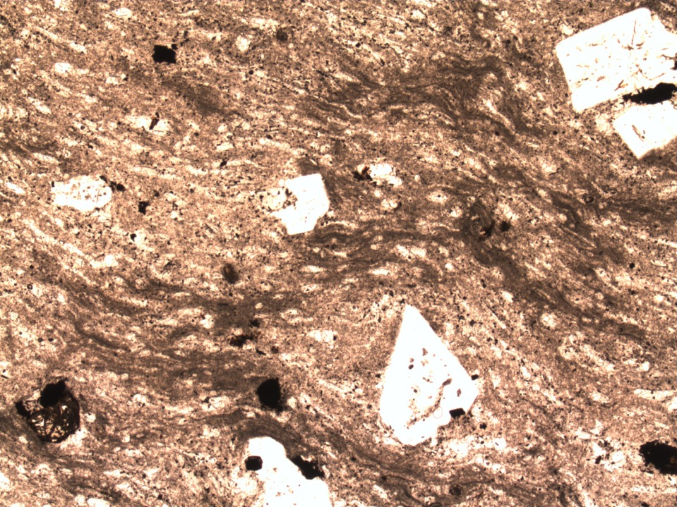
Notes:
USGS 1475_1PL_20x
Porphyritic, devitrified densely welded tuff.
No significant work done on this one yet.

Slide 10
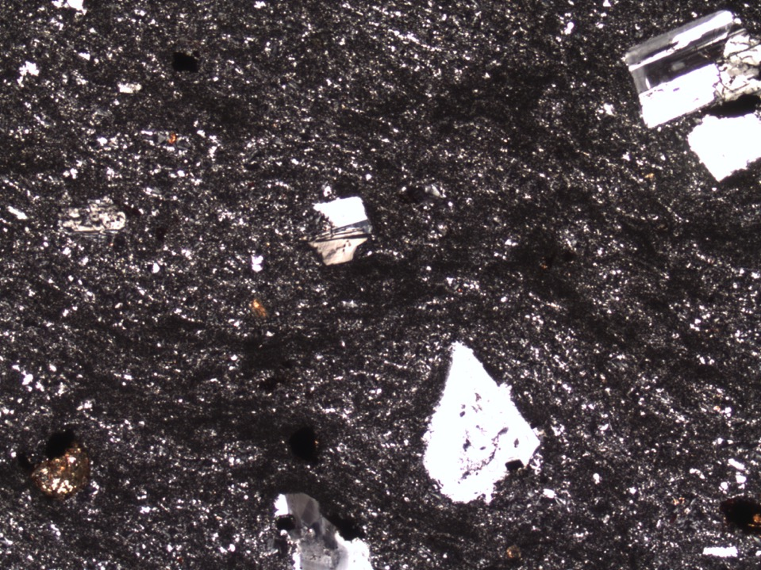
Notes:
USGS 1475_1PL_20x
Porphyritic, devitrified densely welded tuff.
No significant work done on this one yet.

Slide 11
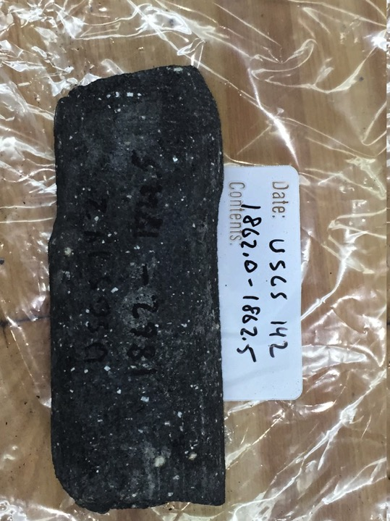
Notes:
USGS 1862 core sample

Slide 12
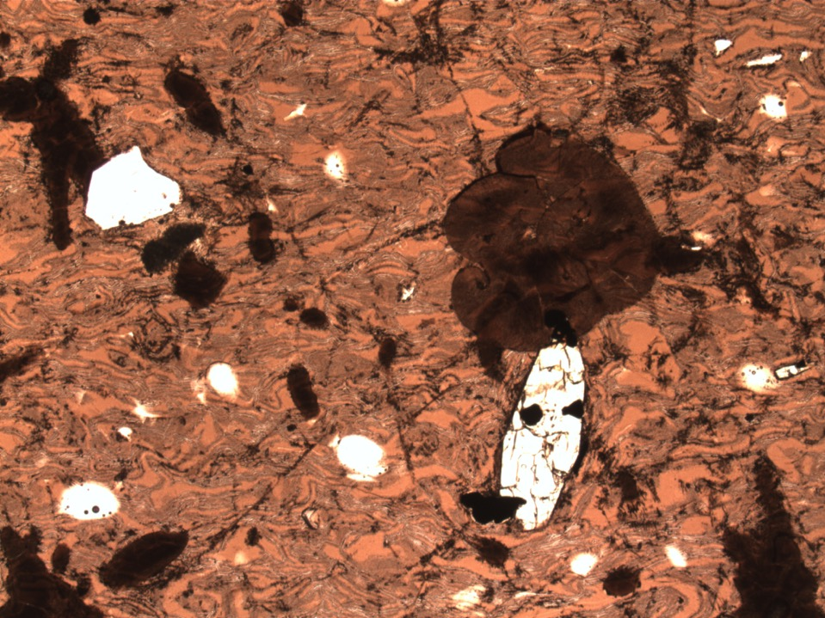
Notes:
US1862_1PL_20X
Densely welded tuff vitrophyre. Incipient devitrification, mainly spherulitic devitrification.
5% Pl >> Ferroaug = Mt > opx > san + accessory ap, zrn. Did not find quartz in this sample; Mt appears more abundant than in samples from upper parts of ignimbrite.
At least 3 textural populations of plag: 1. large, blocky subhedral to euhedral grains with weak oscillatory to normal zoning; bands of MI’s. 2. prominent grains with anhedral, resorbed cores (antecrysts?) mantle by euhedral to subhedral rims. 3. boxy celluar to sieved plag.
Note well defined bubble wall shards.

Slide 13
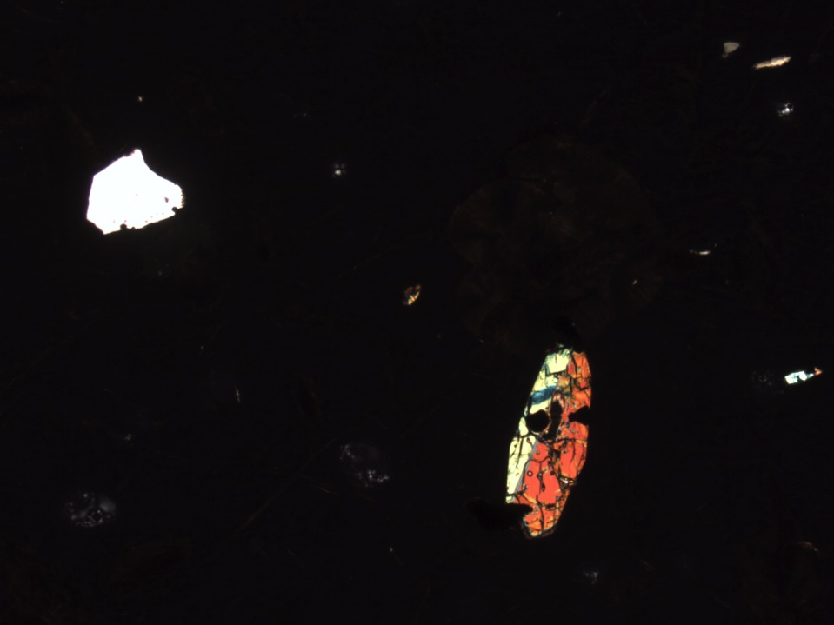
Notes:
US1862_1XP_20X
Densely welded tuff vitrophyre. Incipient devitrification, mainly spherulitic devitrification.
5% Pl >> Ferroaug = Mt > opx > san + accessory ap, zrn. Did not find quartz in this sample; Mt appears more abundant than in samples from upper parts of ignimbrite.
At least 3 textural populations of plag: 1. large, blocky subhedral to euhedral grains with weak oscillatory to normal zoning; bands of MI’s. 2. prominent grains with anhedral, resorbed cores (antecrysts?) mantle by euhedral to subhedral rims. 3. boxy celluar to sieved plag.
Note well defined bubble wall shards.

Slide 14
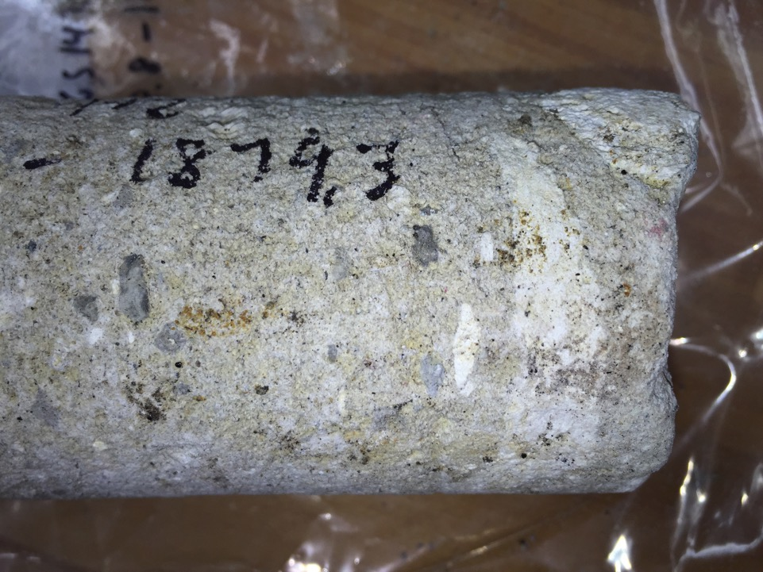
Notes:
US1879 core sample

Slide 15
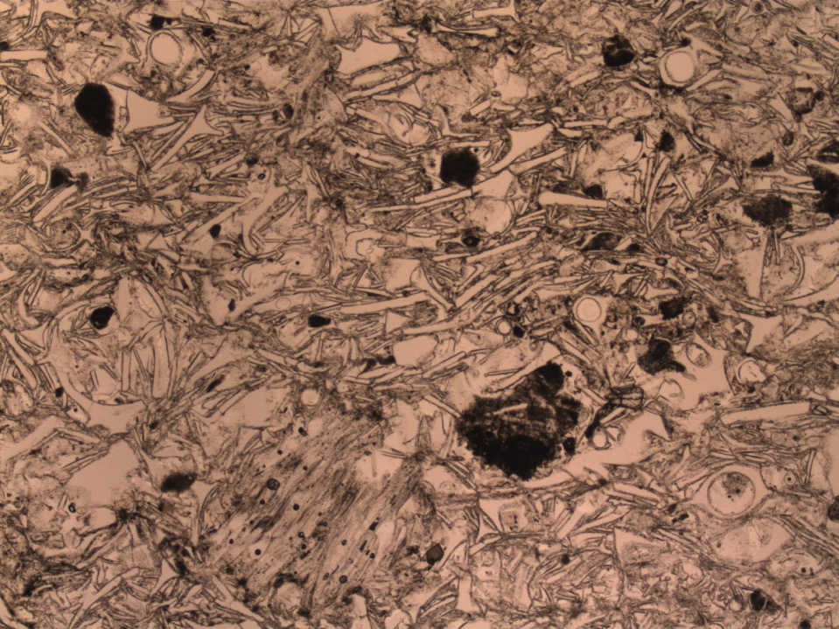
Notes:
USGS142_1879_1PL_20x
Poorly sorted, unwelded tephra. Note well defined bubble wall shards and tubular pumices, as well as lithic fragments (mostly fg rhyolite), and sparse brocken crystal fragments (mostly pl+cpx).

Slide 16
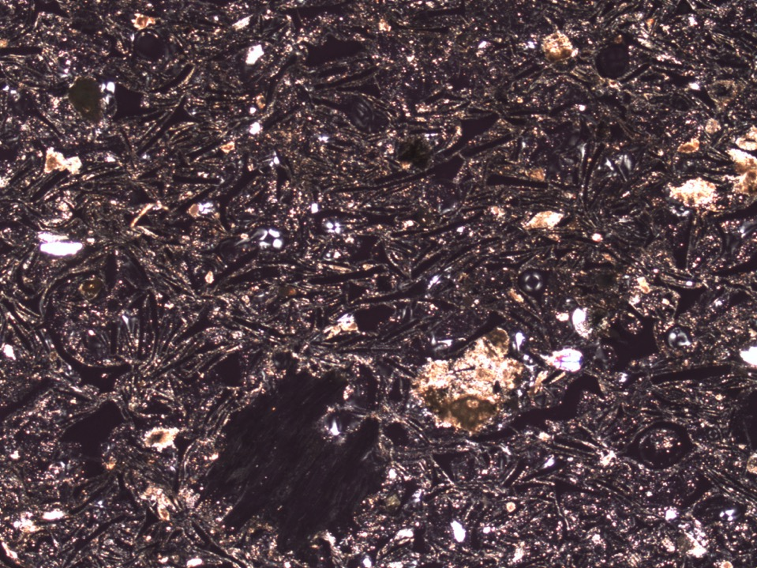
Notes:
USGS142_1879_1XP_20x
Poorly sorted, unwelded tephra. Note well defined bubble wall shards and tubular pumices, as well as lithic fragments (mostly fg rhyolite), and sparse brocken crystal fragments (mostly pl+cpx).

Slide 17
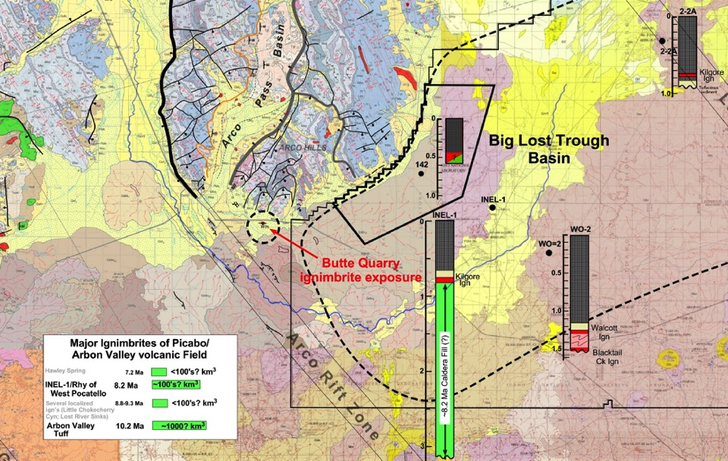
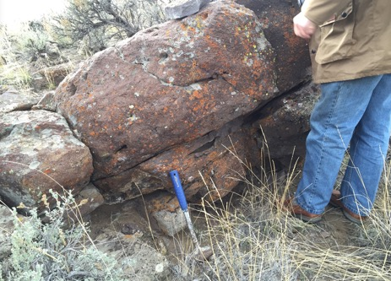
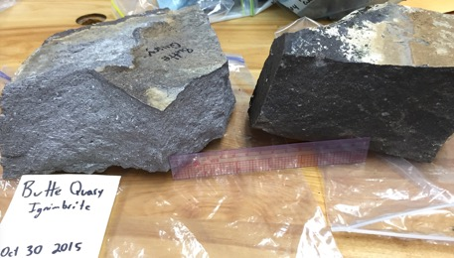
Butte Quarry rhyolite – location, characterization and possible significance

Slide 18
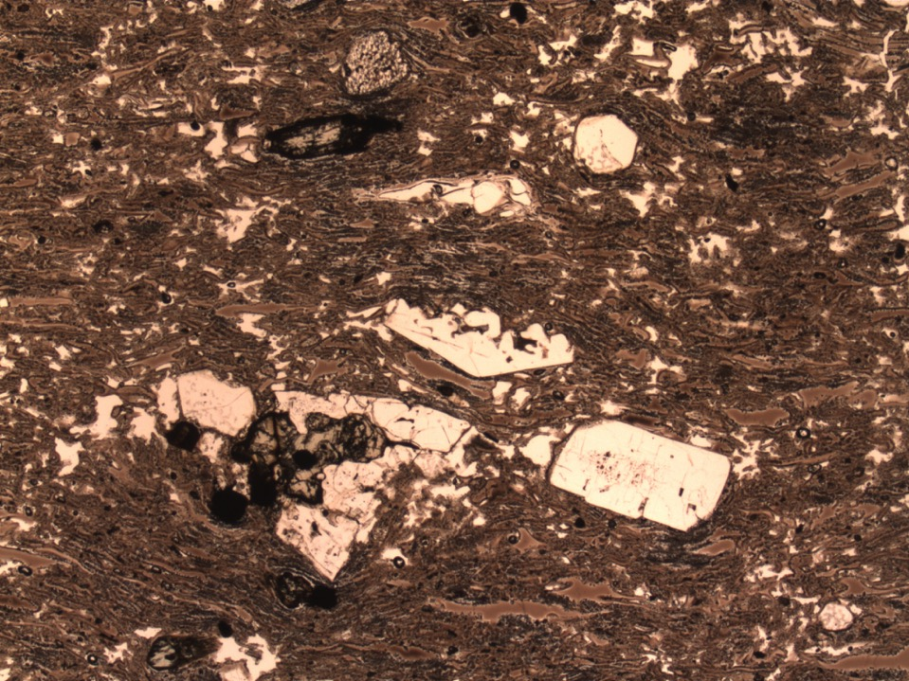
Notes:
Butte Quarry_1_1XP_20X. Rhyolitic moderately welded tuff vitrophyre.
3% Pl > Q > Sa, Ferroaug+Pigeonite+Opx, Mt + accessory zrn, ap. Possible trace of fayalite. Aug+Pigeonite are pretty well identified; need to confirm presence of opx. Unusually complex and diverse feldspar textures and apparent paragenesis (needs detailed work).

Slide 19
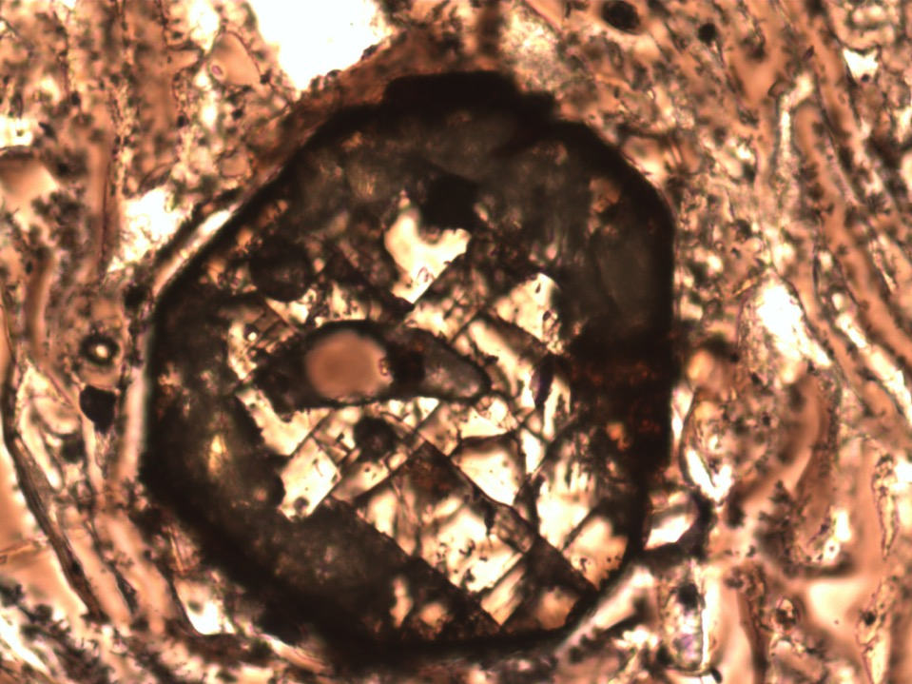
Notes:
Butte Quarry_1_1XP_200X
Euhedral pigeonite (2V ≈ +10 deg)
Rhyolitic moderately welded tuff vitrophyre.
3% Pl > Q > Sa, Ferroaug+Pigeonite+Opx, Mt + accessory zrn, ap. Possible trace of fayalite. Aug+Pigeonite are pretty well identified; need to confirm presence of opx. Unusually complex and diverse feldspar textures and apparent paragenesis (needs detailed work).

Slide 20
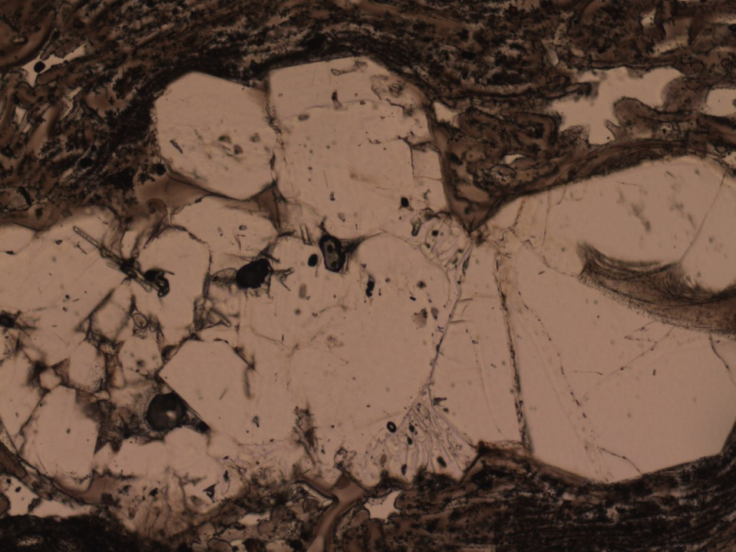
Notes:
Butte Quarry_1_1PL_100X
Glomerocrysts of Qtz+San+Pl; some exhibit granophyric texture
Rhyolitic moderately welded tuff vitrophyre.
3% Pl > Q > Sa, Ferroaug+Pigeonite+Opx, Mt + accessory zrn, ap. Possible trace of fayalite. Aug+Pigeonite are pretty well identified; need to confirm presence of opx. Unusually complex and diverse feldspar textures and apparent paragenesis (needs detailed work).

Slide 21
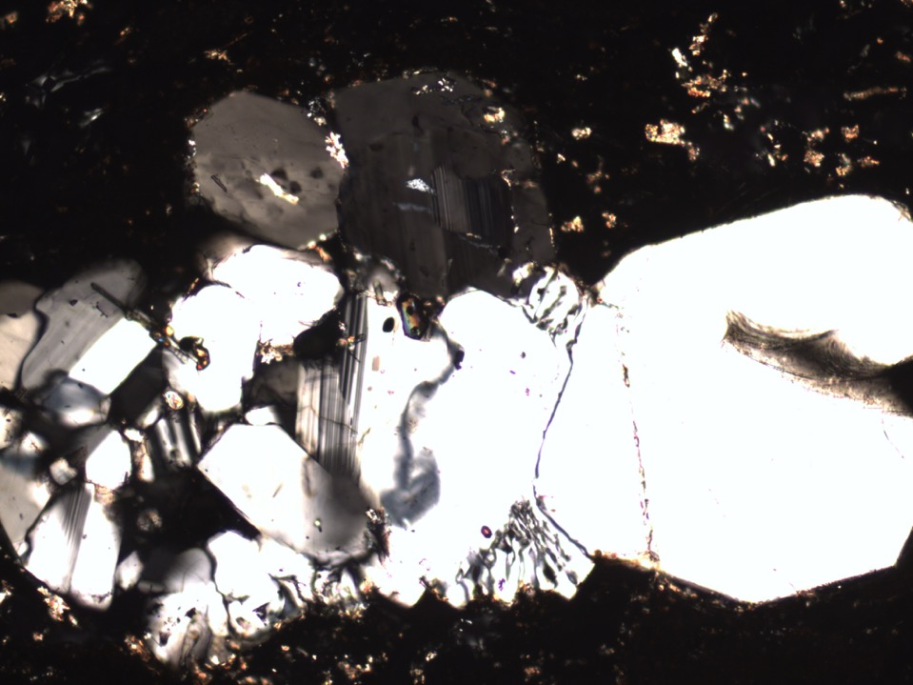
Notes:
Butte Quarry_1_1XP_100X
Glomerocrysts of Qtz+San+Pl; some exhibit granophyric texture
Rhyolitic moderately welded tuff vitrophyre.
3% Pl > Q > Sa, Ferroaug+Pigeonite+Opx, Mt + accessory zrn, ap. Possible trace of fayalite. Aug+Pigeonite are pretty well identified; need to confirm presence of opx. Unusually complex and diverse feldspar textures and apparent paragenesis (needs detailed work).

